Slide 1
Computational Semantics
Human Language from a Computational Perspective
May 16, 2018

Slide 2


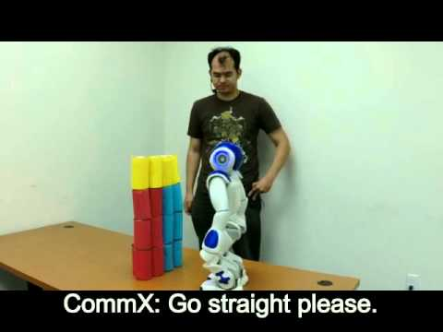

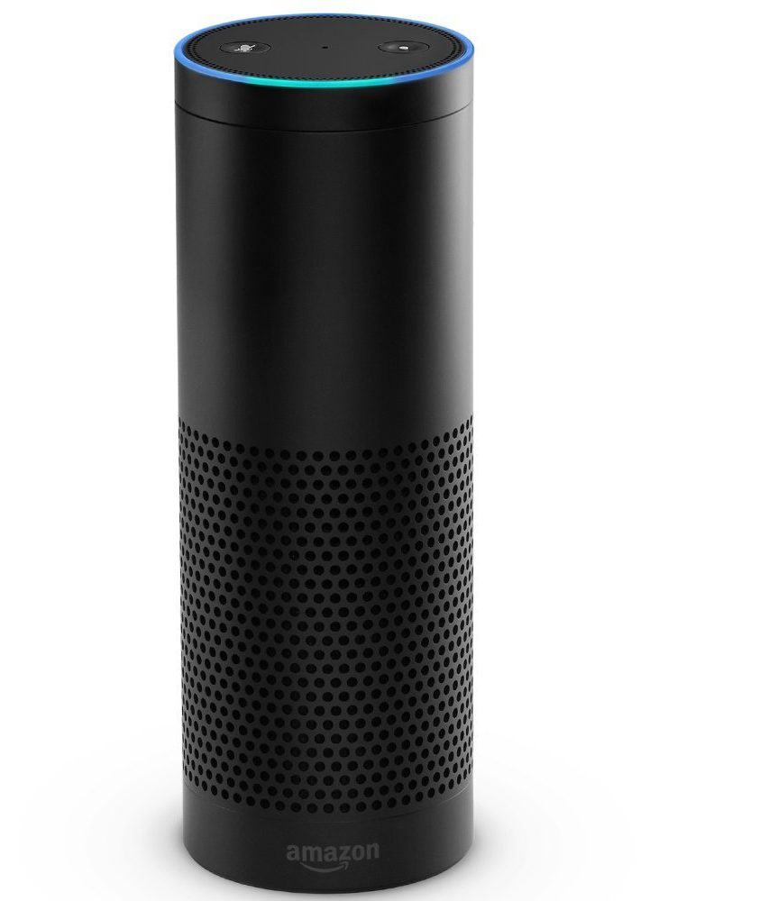

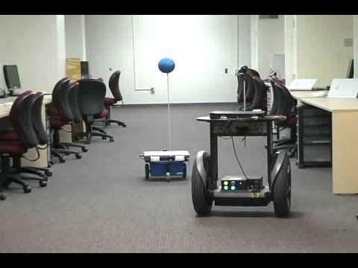
Motivation
Computers can understand language and interact with us
Personal assistants
Intelligence analysis
Robotics
How do they do it?

Slide 3
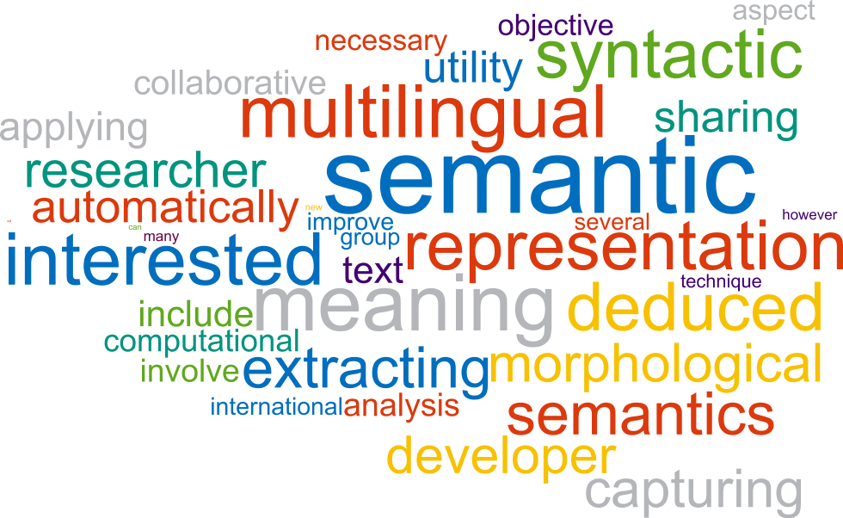
Semantics
Semantics = meaning.
Computational semantics: algorithms to build meaning representation and use it to solve semantic tasks

Slide 4
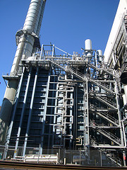
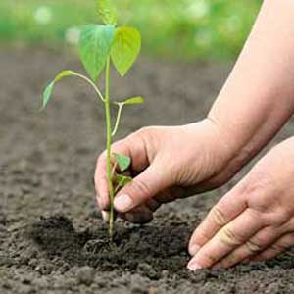
Word sense disambiguation
A word may have more than one sense (meaning).
Which sense of the word is being used?
the new power plant has a production capacity of up to 96 MW
a plant-based diet is still seen as an incredibly hard task to manage
Here both are nouns (NN),
but different parts of speech are possible (wish...)

Slide 5
Resource: WordNet
wordnetweb.princeton.edu/perl/webwn
Synset: collection of words with a specific meaning
(n) plant, works, industrial plant
(n) plant, flora, plant life
(v) plant, set
(v) implant, engraft, embed, imbed, plant
(v) establish, found, plant, constitute, institute

Slide 6
Resource: WordNet
wordnetweb.princeton.edu/perl/webwn
Relations between words/synsets
(n) plant, works, industrial plant
(n) building complex, complex
(n) structure, construction
(n) artifact, artefact
(n) whole, unit
(n) object, physical object
(n) physical entity
(n) entity
(n) plant, flora, plant life
(n) organism, being
(n) living thing, animate thing
(n) whole, unit
(n) object, physical object
(n) physical entity
(n) entity
hypernymy (“is a” relation)
Other possible relations:
meronym (“part of” relation),
pertainym (“of” relation)
entailment (“if-then” relation)

Slide 7
Resource: WordNet
wordnetweb.princeton.edu/perl/webwn
Gloss (definition) for each synset
(n) plant, works, industrial plant (buildings for carrying on industrial labor)
(n) plant, flora, plant life ((botany) a living organism lacking the power of locomotion)
(v) plant, set (put or set (seeds, seedlings, or plants) into the ground)
(v) implant, engraft, embed, imbed, plant (fix or set securely or deeply)
(v) establish, found, plant, constitute, institute (set up or lay the groundwork for)

Slide 8
Resource: WordNet
wordnetweb.princeton.edu/perl/webwn
Frequency counts for each synset
(n) plant, works, industrial plant (63)
(n) plant, flora, plant life (37)
(v) plant, set (8)
(v) implant, engraft, embed, imbed, plant (2)
(v) establish, found, plant, constitute, institute (1)

Slide 9
WSD algorithm
An algorithm can use WordNet (WN) to determine which sense of a word is used in a given sentence.

Slide 10
WSD algorithm
Input: a list of tokens (sentence), target word, WordNet
Output: sense number (according to WN) for target word
wsd(this plant is in the industrial zone, plant, WN) = 1
wsd(a plant is a living thing, plant, WN) = 2

Slide 11
Lesk algorithm for WSD
For each sense, get the gloss (definition).
Count how many words in the sentence are also in the gloss (overlap).
If all senses have a zero overlap, return the sense with the highest frequency.
Otherwise, return the sense with the highest overlap.

Slide 12
Lesk algorithm for WSD
lesk(L, w, WN): ▹ L: list of tokens, w: target word
S ← synsets(WN, w)
s ← argmax(freq(S)) ▹ get sense with highest frequency
m ← 0
i ← 1
while i ≤ len(S): ▹ find sense with highest overlap with L
if overlap(L, gloss(S[i])) > m:
m ← overlap(L, gloss(S[i]))
s ←S[i]
i ← i + 1
return s

Slide 13

Lesk algorithm for WSD
number | gloss | frequency
1 | buildings for carrying on industrial labor | 63
2 | (botany) a living organism lacking the power of locomotion | 37
3 | put or set (seeds, seedlings, or plants) into the ground | 8
4 | plant (fix or set securely or deeply) | 2
5 | set up or lay the groundwork for | 1
lesk(this plant is in the industrial zone, plant, WN) = 1

Slide 14
Lesk algorithm for WSD
number | gloss | frequency
1 | buildings for carrying on industrial labor | 63
2 | (botany) a living organism lacking the power of locomotion | 37
3 | put or set (seeds, seedlings, or plants) into the ground | 8
4 | plant (fix or set securely or deeply) | 2
5 | set up or lay the groundwork for | 1
lesk(a plant is a living thing, plant, WN) = 2

Slide 15

Lesk algorithm for WSD
number | gloss | frequency
1 | buildings for carrying on industrial labor | 63
2 | (botany) a living organism lacking the power of locomotion | 37
3 | put or set (seeds, seedlings, or plants) into the ground | 8
4 | plant (fix or set securely or deeply) | 2
5 | set up or lay the groundwork for | 1
lesk(she works in a power plant, plant, WN) = 2
There are better algorithms today.

Slide 16
Semantic role labeling
What are the semantic relations within the sentence?
(Specifically, predicates and their arguments.)
Example:
Arguments
After graduation , John moved to Paris .
Relation

Slide 17
Resource: PropBank
propbank.github.io
Roleset: collection of relations with a specific meaning, and a definition of numbered roles
give.01 , transfer
Roles:
Arg0: giver
Arg1: thing given
Arg2: entity given to
give.17 , yield when pressure is applied
Roles:
Arg1: thing yielding
Arg2: to what

Slide 18
Resource: PropBank
propbank.github.io
win.01 , win, win a prize/contest
Roles:
Arg0: winner
Arg1: prize
Arg2: contest
Arg3: beneficiary
Arg4: loser, giver of prize
Arg5: in exchange for
Examples:
The PLO failed to win membership in the World Health Organization.
Wall Street's old guard seems to be winning the program-trading battle.
She won grant money for the school.
A wine that wins high ratings from the critics will eventually move.
He won D.T.'s queen for two minor pieces and two pawns.
Arg0
Arg1
Arg0
Arg2
Arg0
Arg1
Arg3
Arg0
Arg1
Arg4
Arg0
Arg1
Arg5

Slide 19
SRL algorithm
An algorithm can use PropBank (PB) to determine which phrases in the sentence correspond to which arguments.
Let’s assume we already know which word in the sentence is the relation, and which sense (that is, roleset) is used...

Slide 20
SRL algorithm
Input: a list of tokens, target word (relation), sense,
phrase structure of the sentence, PB
Output: list of phrases and their argument number
srl(she gave him the key, gave, 1, [she: np, him: np, the key: np], PB) =
[she: arg0, him: arg1, the key: arg2]

Slide 21
Simple SRL algorithm
Informal description:
Mark each noun phrase (NP) or prepositional phrase (PP) as an argument,
according to the order in the sentence and the order of argument definitions.

Slide 22
Simple SRL algorithm
srl(she gave the key to him, gave, 1, [she: np, the key: np, to him: pp], PB)
she gave the key to him
she gave the key to him
[she: arg0, the key: arg1, to him: arg2]
give.01 , transfer
Roles:
Arg0: giver
Arg1: thing given
Arg2: entity given to
np
relation
np
pp
arg0
arg1
arg2

Slide 23
Simple SRL algorithm
srl(she was given the key by him, given, 1, [she: np, the key: np, by him: pp], PB)
she was given the key by him
she was given the key by him
[she: arg0, the key: arg1, by him: arg2]
It should be: [she: arg2, the key: arg1, by him: arg0]
give.01 , transfer
Roles:
Arg0: giver
Arg1: thing given
Arg2: entity given to
np
relation
np
pp
arg0
arg1
arg2

Slide 24
SRL algorithm
We can improve the algorithm by adding rules for passive verbs and so on, but there are better methods today.

Slide 25
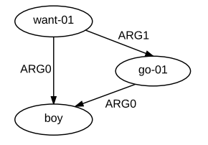
Abstract Meaning Representation
amr.isi.edu
Convert the sentence into an abstract graph that describes all entities and relations
The boy wants to go
Using PropBank for relation and role definitions

Slide 26
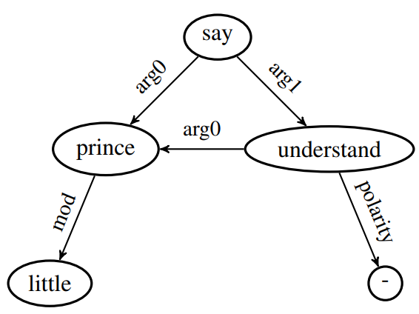
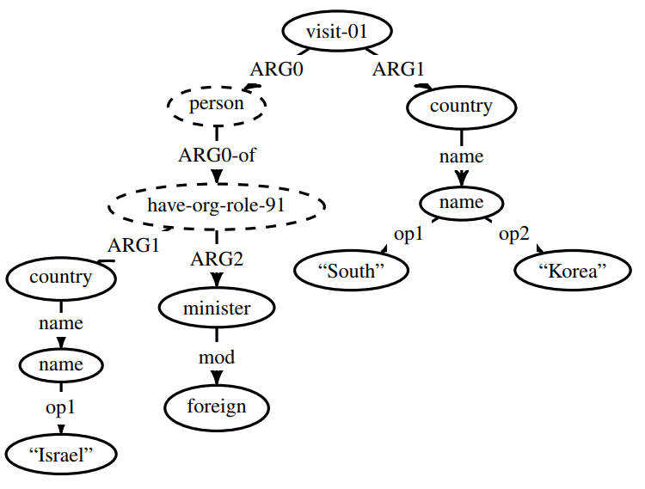
Abstract Meaning Representation
amr.isi.edu
“I do not understand”, said the little prince.
Israel foreign minister visits South Korea.

Slide 27
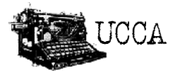
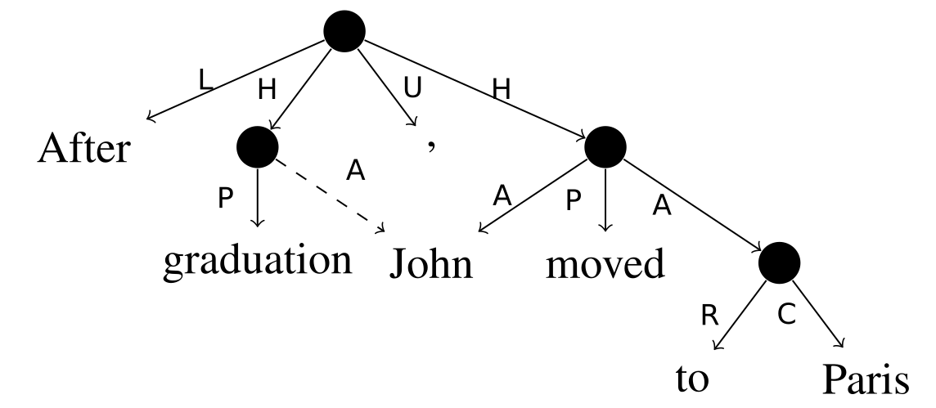
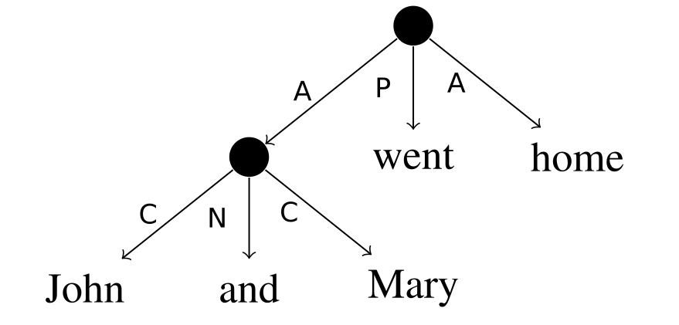
Universal Conceptual Cognitive Annotation
www.cs.huji.ac.il/~oabend/ucca.html
H parallel scene D adverbial N connector U punctuation
A participant E elaborator P process LR link relation
C center G ground R relator LA link argument
L linker S state F function

Slide 28
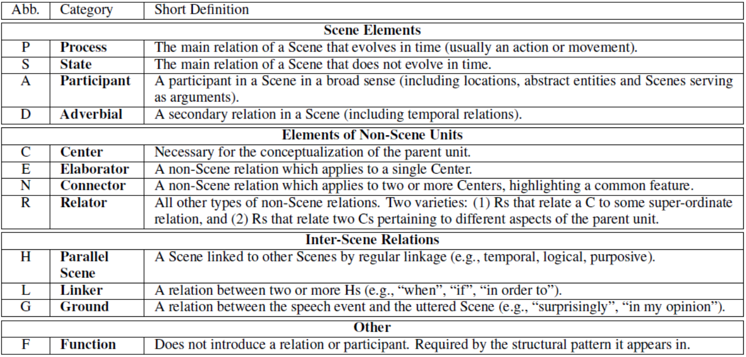
Universal Conceptual Cognitive Annotation
www.cs.huji.ac.il/~oabend/ucca.html

Slide 29
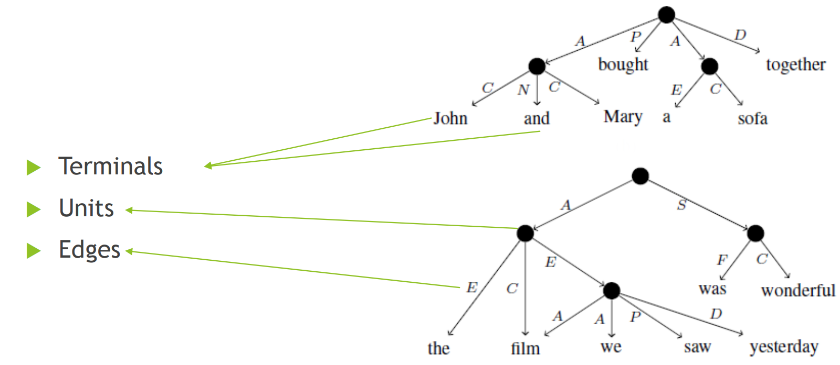
Universal Conceptual Cognitive Annotation
www.cs.huji.ac.il/~oabend/ucca.html

Slide 30
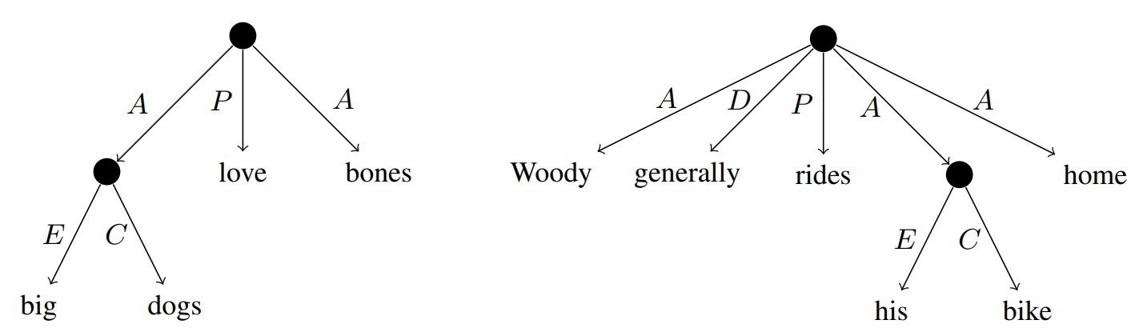
Universal Conceptual Cognitive Annotation
www.cs.huji.ac.il/~oabend/ucca.html

Slide 31
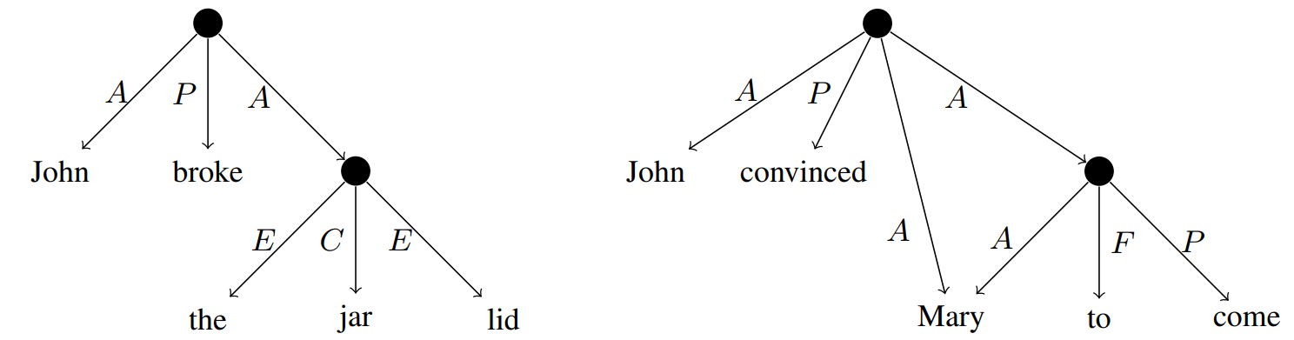
Universal Conceptual Cognitive Annotation
www.cs.huji.ac.il/~oabend/ucca.html

Slide 32
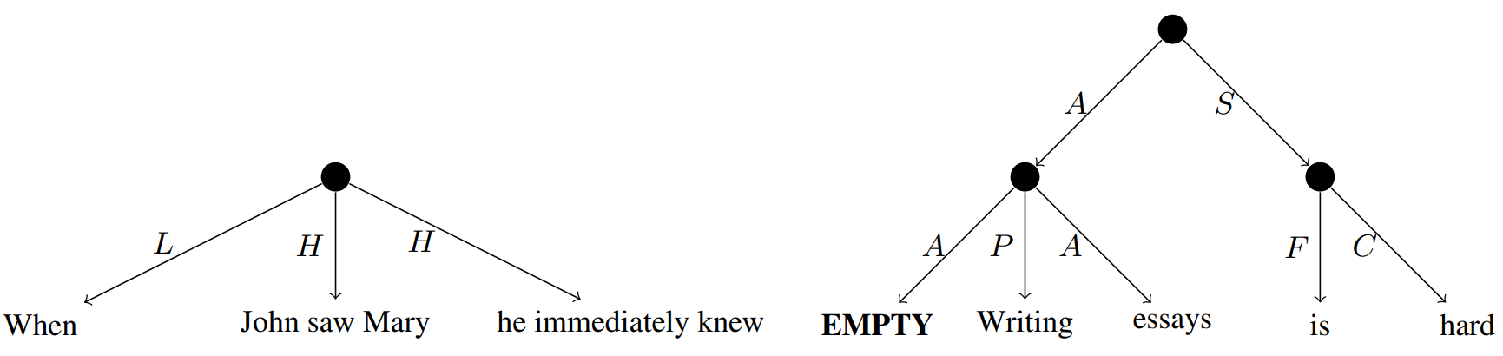
Universal Conceptual Cognitive Annotation
www.cs.huji.ac.il/~oabend/ucca.html

Slide 33
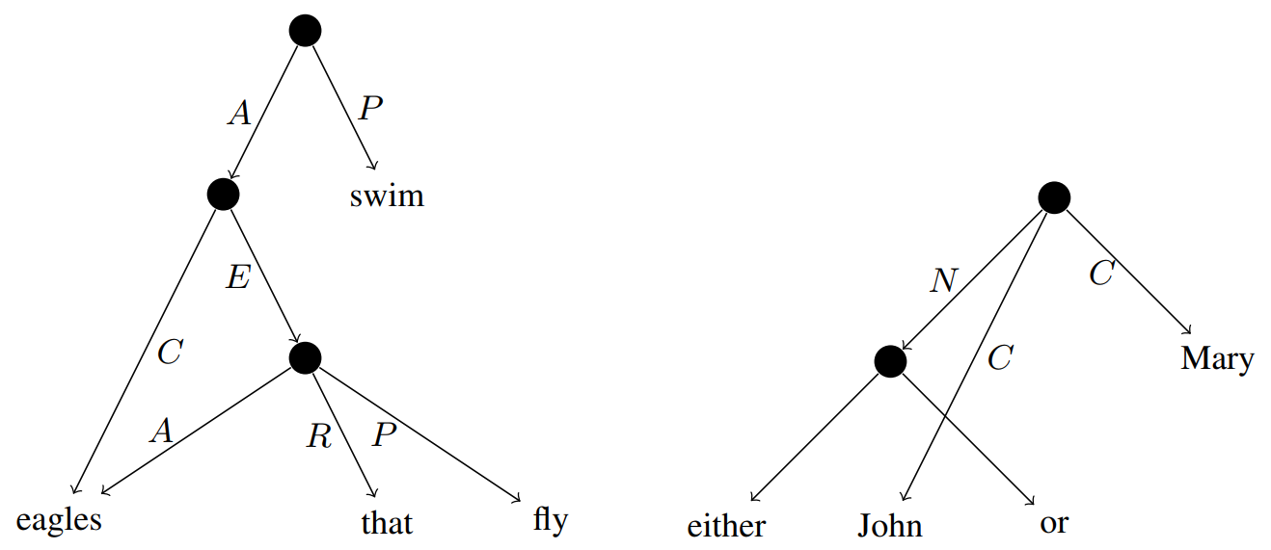
Universal Conceptual Cognitive Annotation
www.cs.huji.ac.il/~oabend/ucca.html

